Slide 1
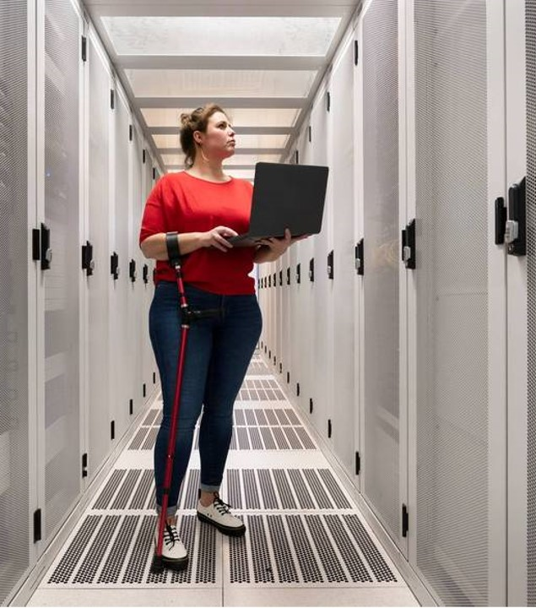
Computer Engineering
101
Presentation by:
Prof. Gehad Kerazi

Slide 2


Intro to the Fundamentals of Computer Engineering
o1.
Intro to Computer Engineering
o2.
Digital Logic and Boolean Algebra
o3.
Computer Architecture
o4.
Programming Fundamentals
o5.
Data Structure and Algorithms

Slide 3

Lesson One
We will cover these skills
Basic concepts
Overview of hardware and software
Intro to computer systems and application

Slide 4

Skill one: Understanding computer components
Functionality of the central processing unit (CPU). Explore the central processing unit (CPU) in detail, delving into its role as the "brain" of the computer. Discuss how the CPU executes instructions, performs arithmetic and logical operations, and manages data flow within the computer system.
Overview of memory systems. RAM, ROM, and cache: Dive into the different types of computer memory systems, including random access memory (RAM), read-only memory (ROM), and cache. Explain how each type of memory functions, their purpose in data storage, and their impact on computer performance.

Slide 5
Skill one: Understanding computer components (2)
Role of input/output devices in computer systems. Examine the significance of input/output devices in computer systems. Discuss how input devices like keyboards and mice enable users to interact with the computer, while output devices such as monitors and printers present information and results. Highlight the importance of input/output devices in facilitating communication between users and the computer.

Slide 6
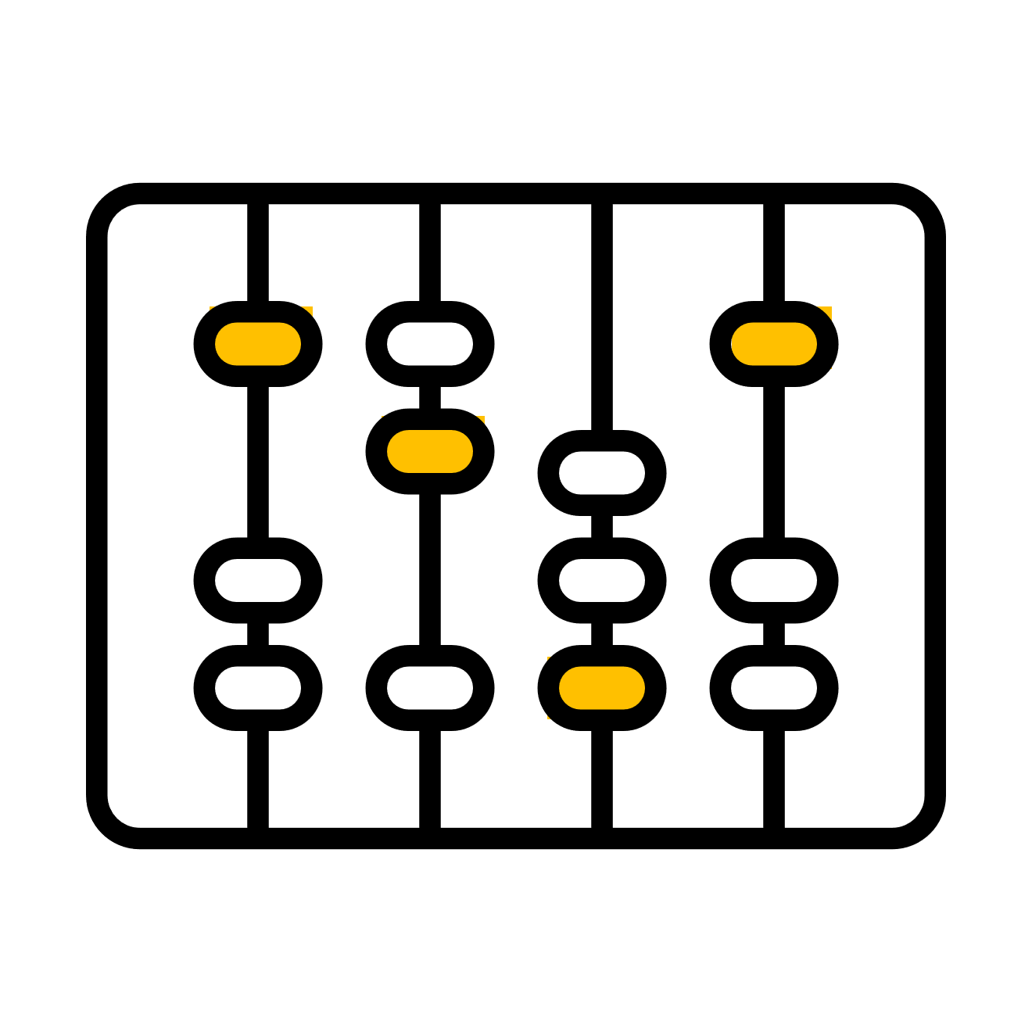

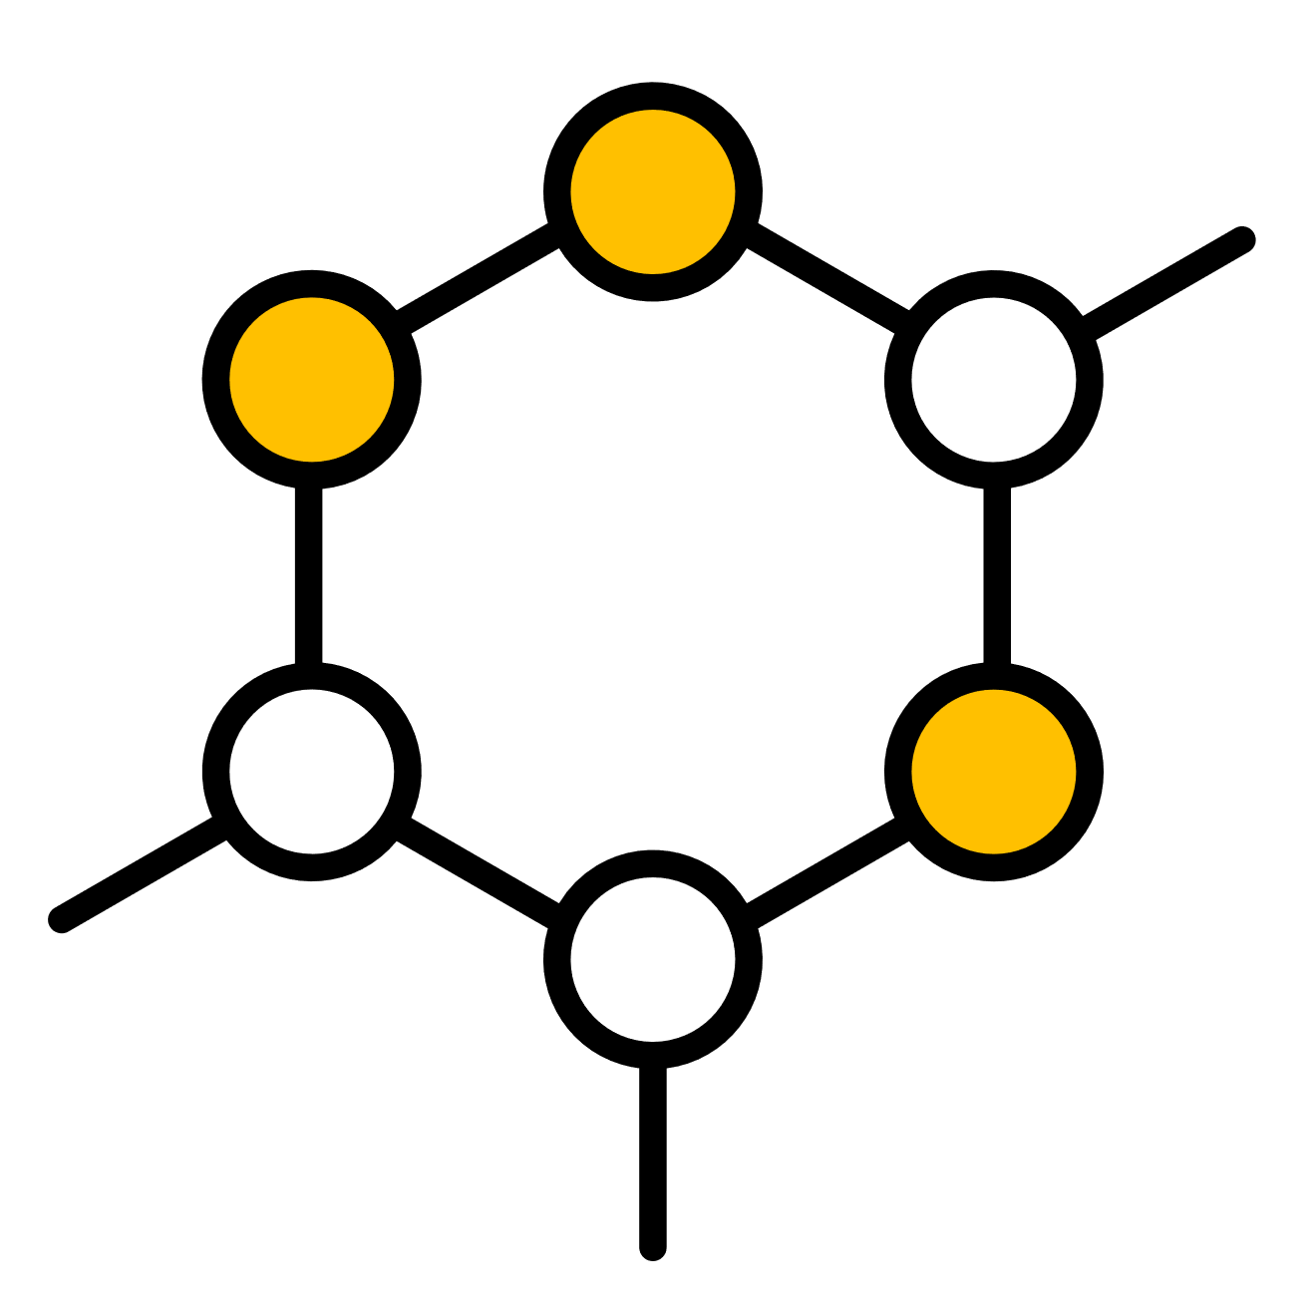
Skill two: Introduction to digital logic
Formula
Logic
Sequence
Boolean algebra and its significance in computer generating
Logic gates: and, or, not, and their truth tables
Combinational and sequential circuits

Slide 7



Skill two: Introduction to digital logic (2)
Formula
Logic
Sequence
Boolean algebra and its significance in computer generating
Logic gates: and, or, not, and their truth tables
Combinational and sequential circuits

Slide 8
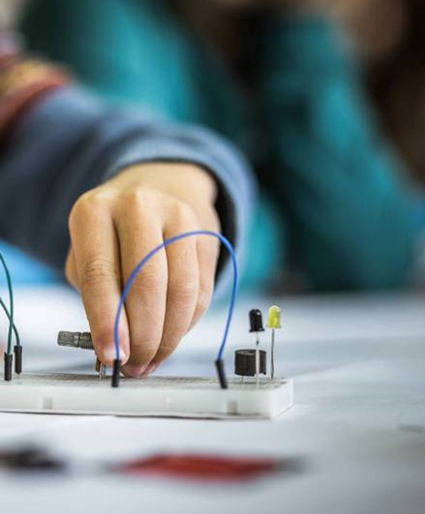
Skill three: Computer architecture
An overview of the fundamental principles that govern the design and structure of computer systems, including topics like instruction set architecture, data representation, and system organization.
Explore the internal structure and organization of a central processing unit, including registers, arithmetic logic units, control units, and pipelines.
Discuss the concept of memory hierarchy and its impact on computer performance, covering various levels of memory such as cache, main memory, and secondary storage devices.

Slide 9
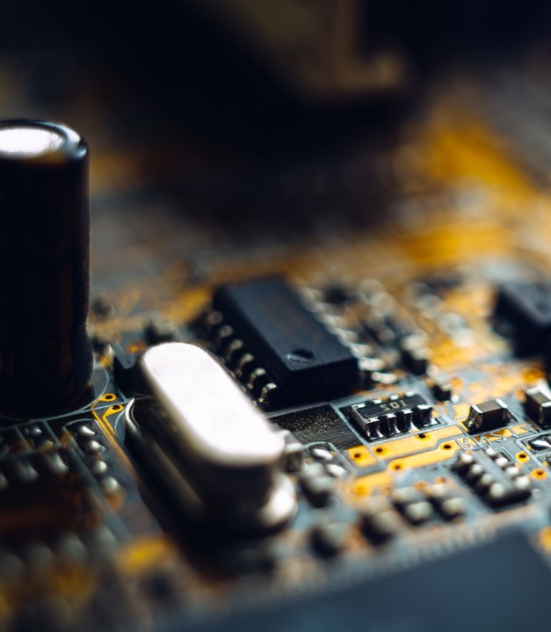
Lesson one summary
What we’ve learned so far
Skill one
Familiarize students with the basics of computer engineering and the key components of a computer system.
Skill two
Introduce students to digital logic, Boolean algebra, and the design of logic circuits.
Skill three
Explore the internal organization of computers, including CPU design and memory systems.

Slide 10

Course progress
o1.
Intro to Computer Engineering
o2.
Digital Logic and Boolean Algebra
o3.
Computer Architecture
o4.
Programming Fundamentals
o5.
Data Structure and Algorithms

Slide 11
Course progress (2)
o1.
Intro to Computer Engineering
o2.
Digital Logic and Boolean Algebra
o3.
Computer Architecture
o4.
Programming Fundamentals
o5.
Data Structure and Algorithms

Slide 12

Thank you
Office hours:
M-Th 3:00pm-4:30pm room C402
Please send all questions to:
gehad@example.com

